Slide 1
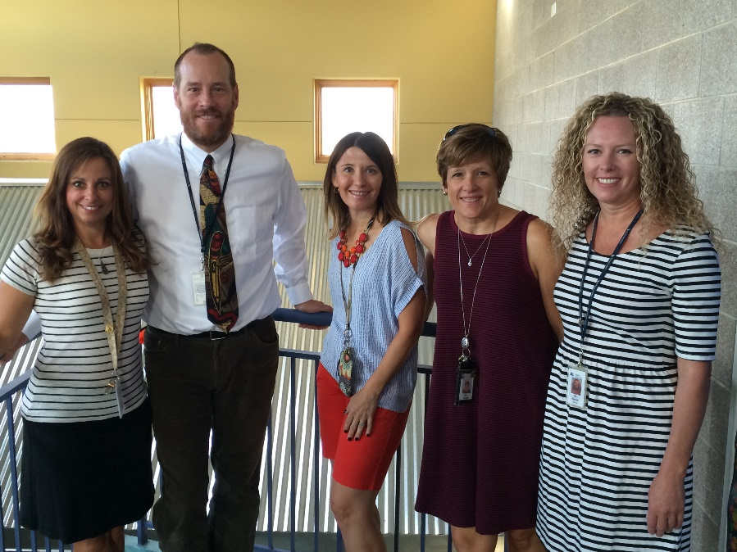
Welcome to Fourth Grade!
Mrs. Arnoff, Mrs. Drage, Ms. Mocke, Mrs. Mozer ,
Mr. Hitchcock

Slide 2
A message from mrs. alfonso
Mrs. Alfonso Message

Slide 3
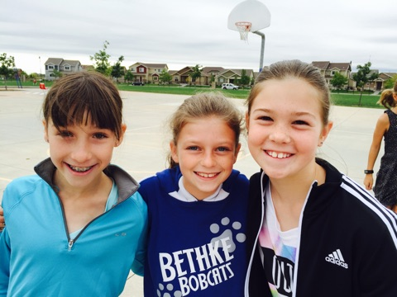
=
Please sign up for a conference if you have not done so yet.
You will also need to view the Code of Conduct online. We will need one signed sheet per family.
Student verification forms are on your child’s desk. Please look over the information carefully and make any necessary changes before returning them to me.

Slide 4
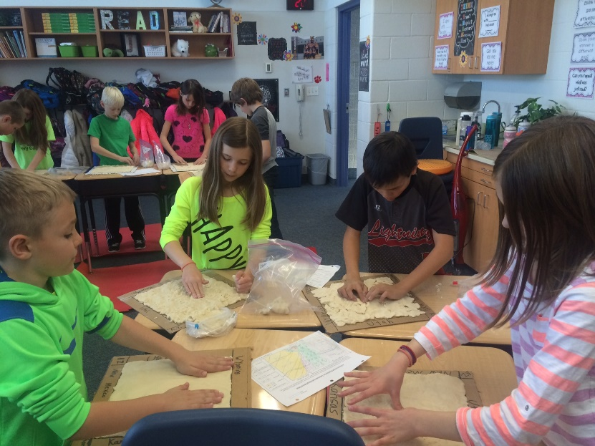
Communication
Bi-monthly email communication
Email
Common Fourth Grade website
Phone: 970-488- 4347
Open-door policy
Don’t wait if you have a concern.
Please email or call to set up a time to meet.

Slide 5
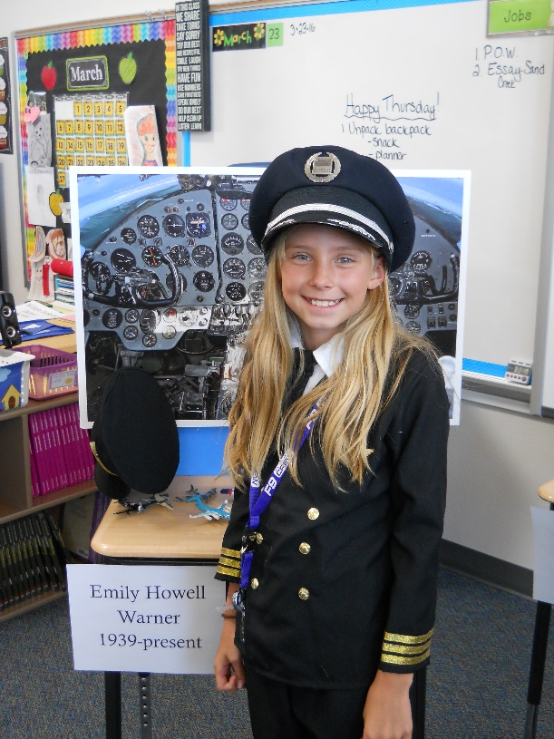
4th Grade Expectations
PBIS / Red Slip
Daily Schedule
Core Map
Grading: A,B,C,D,F
Snack/H2O bottles
Birthday Celebrations
Friday Responsibility Recess—3 yellows, 1 red, missing homework or daily work

Slide 6
Field Trip/Projects
Heart Dissection (May)
Colorado History Museum (March 7th)
Fort Collins Symphony (January)
Rendezvous (April)
Two at home projects:
Salt Dough maps (mixing flour only)
Wax museum (editing paper)

Slide 7
Blue Handbook
Attendance line
Please call 488-4301 and email jbrase@psdschools.org
Drop-off/Pick-up
We have extended the drop off/pick up car line through the red zone. Please continue pulling forward to wait for your child and stay in your car.
Students are dismissed at 3:13
8:15 is drop-off outside.
Students are tardy at 8:35
Park in the front of the building
Only use front doors of the school-all others are locked

Slide 8
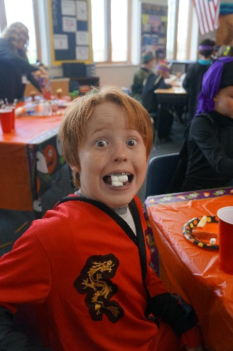
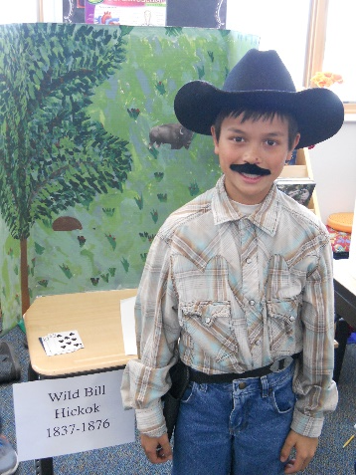
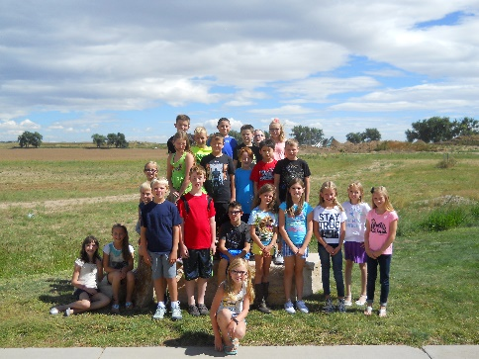
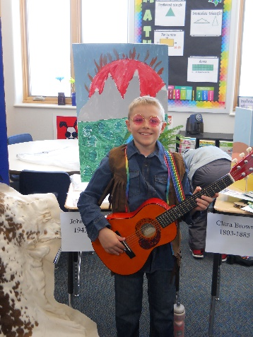
Blue Handbook (Continued)
School Calendar
Use of personal technology-we will have special days/times for this
Non-permission slips for pictures on websites and email

Slide 9
Lunchroom
Breakfasts are now available from 8:10-8:30. Enter through the cafeteria recess doors
We go to recess at 12:15 and come in to eat at 12:40
Blue paw print stamp on your child’s hand = one lunch remaining
Microwave for 4-5 grades only
Eating with your child—we recommend no more than 1x/week

Slide 10
Fourth Grade Homework
Homework policies are consistent throughout the grade level.
Words their Way-Every two weeks
Sayings/Idioms will come home each Friday and due the following Thursday.
Math homework will be daily. Related to the current lesson. No more than 10-15 minutes.
Reading 20 minutes daily.
We realize families are busy and in an effort to respond to the most recent parent survey, we are making all homework meaningful and not busy work.

Slide 11
Envision Pearson Math App
Download app in iTunes or Android stores.
Open app, scan homework
Video on topic will open for help

Slide 12
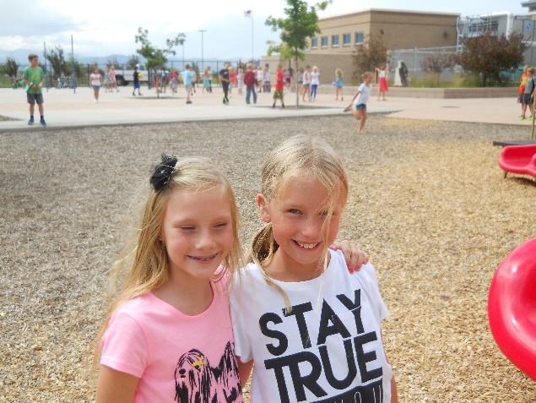
New Trimester
November 10, 2016 end of trimester 1
February 16, 2017 end of trimester 2
May 19, 2017 end of school year

Slide 13
MTSS
We are committed to “Honoring All Learners” and helping every student succeed.
We follow Colorado law and have a framework in place to support students within our school called Multi-Tiered System of Supports.
If your child is ever in need of intense intervention, his/her teacher will notify you, as your permission is required.

Slide 14
“Honoring all learners”
Questions?

